Slide 1
The Team Formerly Known As: FPL
T506: Material Handling Robot
Team: Taylor Harvey, Nicholas Norwood, Diandra Reyes, Peter Watson, Alexander Wozny

Slide 2





ME Senior Design Team 506
NICHOLAS NORWOOD
Controls Engineer
PETER WATSON
Materials Engineer
DIANDRA REYES
Additive Manufacturing Engineer
ALEXANDER WOZNY
Systems Engineer
TAYLOR HARVEY
Mechanical Design Engineer
Notes:
No such thing as too fancy

Slide 3


Senior Design ECE Team
WALTER CALDWELL
Project Manager
TIFFANY MILLER
Hardware Engineer
SEBASTIAN MURIEL
System Engineer
ALEX JEN
Software Engineer
TONY ZHENG
Financial Advisor

Slide 4




Sponsors
Project Sponsor
Dr. Jerris Hooker
Project Advisor
Dr. Camilo Ordóñez
Dr. Shayne McConomy
FAMU – FSU College of Engineering

Slide 5


Objective
The objective of this project is to create a partially autonomous material handling robot that works in a dark warehouse with conditions unfavorable to human workers.

Slide 6
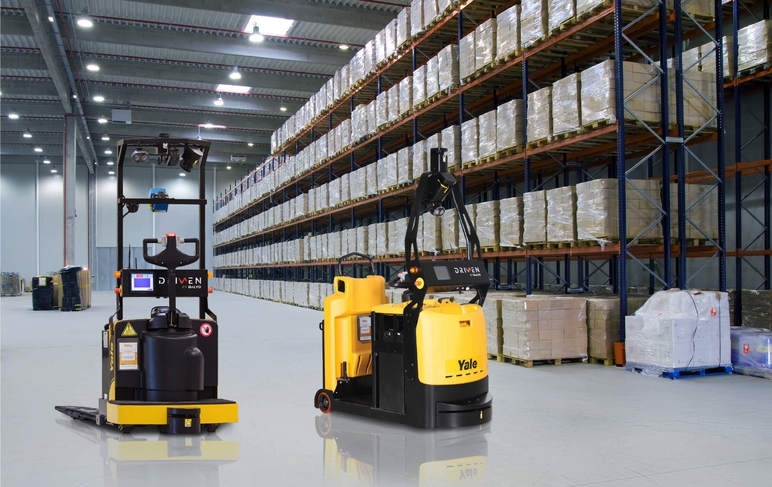
Dark Warehouses
Semi-Autonomous warehouse where robots do most of the labor
Humans provide managerial role over robots
Reduce costs and increase profits
No lights or AC needed
Robots can work 24 hours a day
Less staff needed to manage the warehouse
'Warehouse of the future'

Slide 7
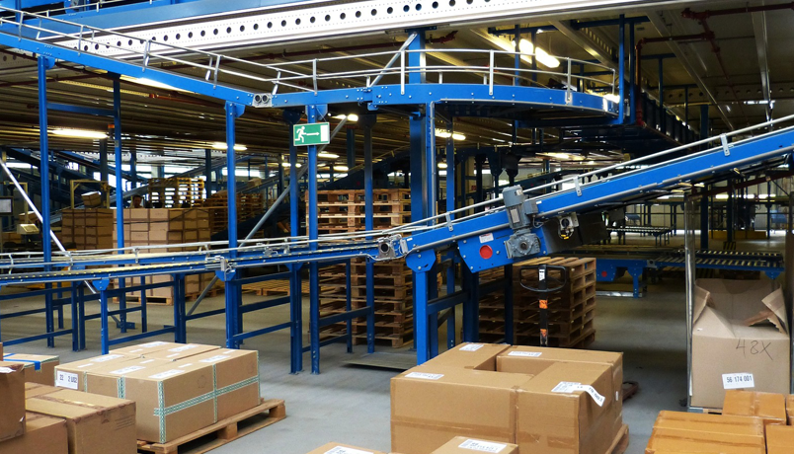
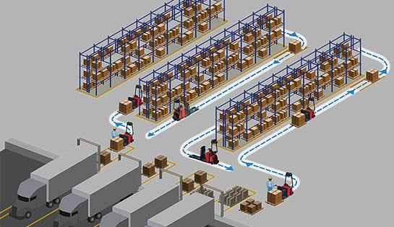
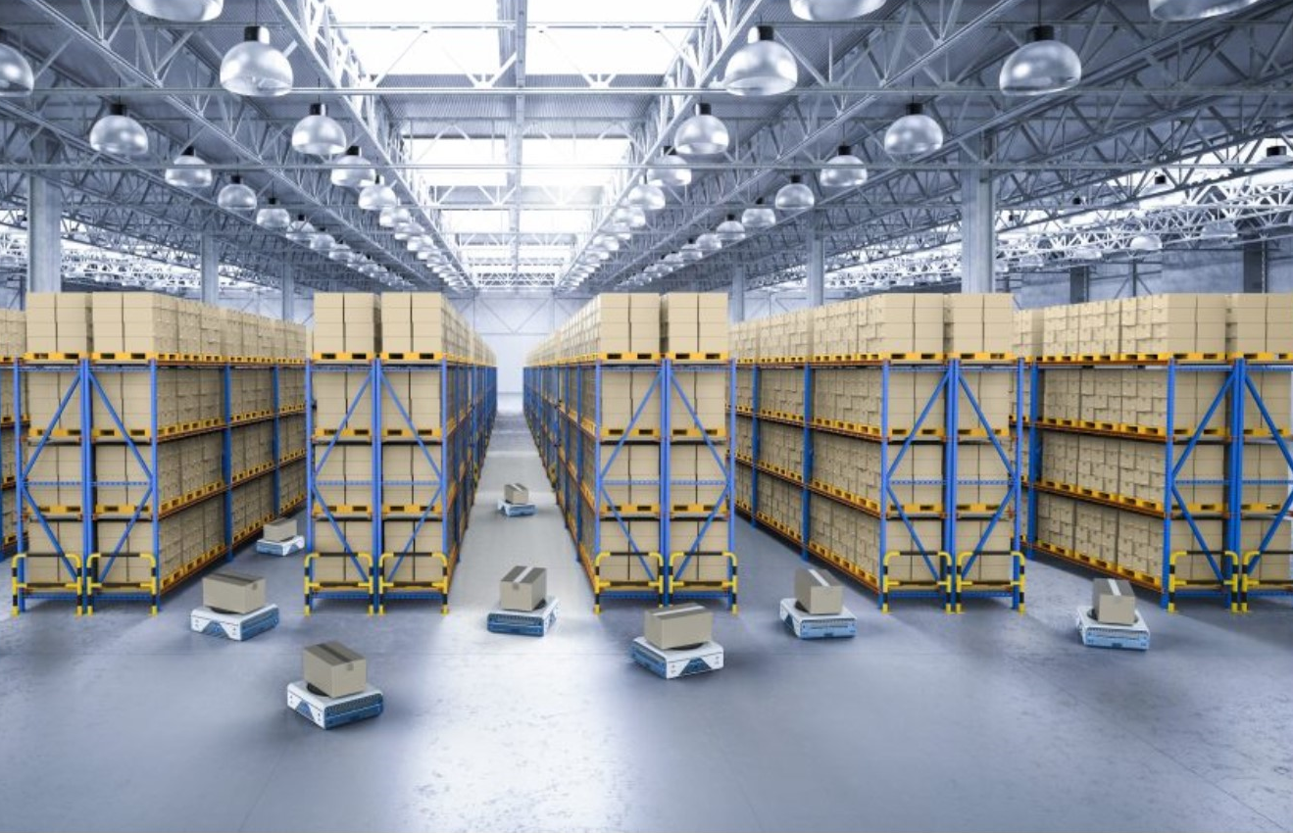
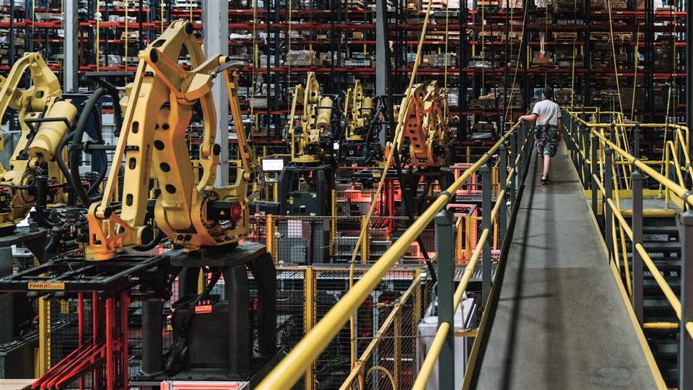
Background Information
Sorting conveyor belts
Self- navigating forklifts
Automated Warehouses
Automated ground vehicles
Material handling robotic arm
Notes:
To understand the concept of this project it is important to understand the rising use of dark warehouses
Dark warehouses are considered the “warehouses of the future” specifically b/c of the technological components that make up a dark warehouse
Increase in automation and robotics to complete tasks, retrieve products, and properly store them as well as increase performance, and speed in sorting system.
Different types of automated systems implicated in dark warehouses: robotic arms assembling, conveyor belts sorting, forklifts self navigated and AGV retrieving and moving product
Most if not all these systems are controlled through an interface that connect the machinery to the supply chain
Though many companies may view warehouse automation as an “all or nothing” investment due to the desire of being completely automated, there are many benefits to implicated automated steps into the supply chain process.
The warehouse automation industry is projected to double in revenue from $13 billion in 2018 to a possible $27 billion in 2025. It is a growing market with many companies seeing the long-term benefits of switching to automated operations.

Slide 8



Motivation
Cost
Efficiency
Reduces Cost for Utilities
Machines do not need central air units
Operation can happen with less lighting
Reduces Need for Manpower
Safety
Less harsh environmental conditions for human workers
Increase in Operational Time
Robots do not need vacation/sick days/holidays/sleep
Notes:
-reduce cost (no need for 24/7 insulation/lighting b/c robots don’t need that, cut cost on electricity and employment; for manpower: you’d only need the folks taking care of the machines, handling errors, and folks in charge of supply chain management, everybody that was stocking by hand can go)
-increase efficiency (machine would be able to perform inventory tracking, giving user real-time data of supply chain performance)
Humans have a lot of needs as workers in a warehouse. The conditions in a warehouse can often reach extreme temperatures, and require constant lighting. By introducing a dark robot to a warehouse, it will reduce costs of temperature control and lighting expenses.
-

Slide 9

Project Scope

Slide 10


Key Goals
Notes:
Human control; add autonomous control to this as well; have it go right with the human and left autonomous

Slide 11
Notes:
Navigate in the dark

Slide 13
Notes:
- Obstacle avoidance
- Maneuver without collision (includes but not limited to not violently hitting the shelf)

Slide 14

50 LBS
Notes:
Lift up to 50 pounds

Slide 15
50 LBS
Notes:
Robot movement is partially autonomous, and partially under human control
Safely lift and move up to a 50lb load
Track inventory
Avoid obstacles and maneuver itself without collision

Slide 16




Markets
Primary Markets
Secondary Markets
Large warehouses
- Reduces expenses
- Increases productivity
Smaller scale hardware stores
Companies using material handling or inventory tracking
Productivity
Libraries
Labor Costs
Notes:
Library - autonomous robot can reorganize books that are not correct shelf location

Slide 17


Stakeholders
Senior design
TA’s
FAMU-FSU College of Engineering
Project Advisor
Dr. Camilo Ordóñez
Dr. Jerris Hooker
Dr. Shayne McConomy
Dr. Bruce Harvey

Slide 18

Customer Needs
Mobility
Notes:
Customer Needs: customer wants robot to…
- retrieve and deliver things in a warehouse setting (mobility)
Do the same work a human worker would; specified 50 lbs because according to OSHA [Occupational Safety and Health Administration] human workers should have to carry more than 50 lbs (Standard Performance)
Handle items without damaging them (Liability)
Behave autonomous in nature but maintain some sense of control by having a input device (Control)
Connect to supply chain network so personnel can control robots (User Interface)
find charging station and recharge independently (rechargeable)

Slide 19



Customer Needs
Much better
50 lb
Standard Performance
50 lb
Notes:
Customer Needs: customer wants robot to…
- retrieve and deliver things in a warehouse setting (mobility)
Do the same work a human worker would; specified 50 lbs because according to OSHA [Occupational Safety and Health Administration] human workers should have to carry more than 50 lbs (Standard Performance)
Handle items without damaging them (Liability)
Behave autonomous in nature but maintain some sense of control by having a input device (Control)
Connect to supply chain network so personnel can control robots (User Interface)
find charging station and recharge independently (rechargeable)

Slide 20





Customer Needs
Not Reliable
Reliable
Notes:
Customer Needs: customer wants robot to…
- retrieve and deliver things in a warehouse setting (mobility)
Do the same work a human worker would; specified 50 lbs because according to OSHA [Occupational Safety and Health Administration] human workers should have to carry more than 50 lbs (Standard Performance)
Handle items without damaging them (Liability)
Behave autonomous in nature but maintain some sense of control by having a input device (Control)
Connect to supply chain network so personnel can control robots (User Interface)
find charging station and recharge independently (rechargeable)

Slide 21





Customer Needs
Rechargeable
Low battery?
Notes:
Customer Needs: customer wants robot to…
- retrieve and deliver things in a warehouse setting (mobility)
Do the same work a human worker would; specified 50 lbs because according to OSHA [Occupational Safety and Health Administration] human workers should have to carry more than 50 lbs (Standard Performance)
Handle items without damaging them (Liability)
Behave autonomous in nature but maintain some sense of control by having a input device (Control)
Connect to supply chain network so personnel can control robots (User Interface)
find charging station and recharge independently (rechargeable)

Slide 22


Customer Needs
I want these bots to move in opposite directions
User Control
Perfect
Notes:
ustomer Needs: customer wants robot to…
- retrieve and deliver things in a warehouse setting (mobility)
Do the same work a human worker would; specified 50 lbs because according to OSHA [Occupational Safety and Health Administration] human workers should have to carry more than 50 lbs (Standard Performance)
Handle items without damaging them (Liability)
Behave autonomous in nature but maintain some sense of control by having a input device (Control)
Connect to supply chain network so personnel can control robots (User Interface)
find charging station and recharge independently (rechargeable)

Slide 23




Customer Needs
User
Interface
DATA ALERT
Notes:
Customer Needs: customer wants robot to…
- retrieve and deliver things in a warehouse setting (mobility)
Do the same work a human worker would; specified 50 lbs because according to OSHA [Occupational Safety and Health Administration] human workers should have to carry more than 50 lbs (Standard Performance)
Handle items without damaging them (Liability)
Behave autonomous in nature but maintain some sense of control by having a input device (Control)
Connect to supply chain network so personnel can control robots (User Interface)
find charging station and recharge independently (rechargeable)

Slide 24





Assumptions
Regular maintenance not included
Traverses flat surfaces
Warehouse will not be altered
Power supply is accessible
Product is working indoors
Notes:
Will not provide regular services or maintenance for the robot.
Robot will only traverse over flat surfaces and no rugged terrain
The Mechanical engineering side of the group will be responsible for the package manipulation, whereas the Electrical engineering group will focus on navigation and movement of the robot

Slide 25



Functional Decomposition
Locomotion
Manipulation
Navigation
Notes:
Main Functions:
- Navigation
(Different key words for icons: map, path, maze, )
- Manipulation (Package)
(Different key words for icons: move, package, )
- Locomotion
(Different key words for icons: car, drive, wheel, move, vehicle, )

Slide 27



Slide 28
Notes:
Possible Idea for displaying function decomposition: Part 1

Slide 29

Notes:
Possible Idea for displaying function decomposition: Part 1

Slide 30
Progress Report
COMPLETED
IN PROGRESS
PENDING
Project Charter
Sponsor Meet And Greet
Work Breakdown Structure
Project Scope
Customer Needs
Functional Decomposition
Advisor Meet And Greet
VDR 1
Targets and Metrics
Concept Generation
Concept Selection
Virtual Design Review 2
Notes:
Break down even further

Slide 31









Summary
Partial autonomy
Human Control
Operate in a Dark Environment
Lift Up to 50 lbs
Track Inventory
Rechargeable
Maneuver w/o Collision
Obstacle Avoidance
Notes:
Robot movement is partially autonomous, and partially under human control
Operate in a dark environment
Safely lift and move up to a 50lb load
Track inventory
Avoid obstacles and maneuver itself without collision

Slide 32
Questions?

Slide 38
Appendix

Slide 39
Needs Table
What is the purpose of this robot? | The robot must be able to retrieve and deliver things in a warehouse setting. -Customer | Robot is autonomous in nature and capable of data-processing.
What are the surroundings and environment the robot will be operating in? | It will be used in a warehouse setting. The robot should be able to operate in conditions that are unfavorable to humans (i.e. hot temperatures that could make workers pass out or get heat strokes). -Customer/Dr. McConomy | The robot is able to navigate around a warehouse.
 |  | The robot is able to sense and navigate around obstacles.
 |  | The robot can perform tasks in the dark.
 |  | Also, will perform in temperature conditions undesirable to humans.

Slide 40
Needs Table (continued)
What kind of items should the robot be able to handle? (Approximate weight) | Following OSHA regulations, a person should not be able to carry more than 50 lbs. If the robot were to malfunction a worker must aid it. Thus, the robot should carry a max load of 50 lbs. -OSHA | The robot can carry packages up to 50 lbs.
 |  | The robot will follow OSHA regulations.
 |  | When the robot malfunctions, it sends out an error alert for servicing.
What kind of retrieval methods should the robot achieve? | The robot should be able to pick things in a vertical and horizontal motion. Also, items shouldn’t be damaged when being set down. -Customer | Robot will have multiple degrees of freedom for movement.
 |  | Robot includes grasp force and manipulation control to prevent damaging items.

Slide 41
Needs Table (continued)
Would you want to have a handling input device? | “The robot can be operated under supervisory control. ​” -Customer | The user will operate and control the robot if desired.
What forms of power supply are accessible to you? What kind of power source do you prefer? | The robot has to have some way to recharge its battery fully so it can be active all hours of the working day. -Customer | Robot can operate over a 9-hour period before it has to recharge.
 |  | Robot navigates to an area where it can receive charging before the battery runs out.
Do you need the robot to track inventory as it delivers items? | Yes, it must be able to interface with our supply chain system | The robot will include modules to process machine readable codes and deliver information.

Slide 42
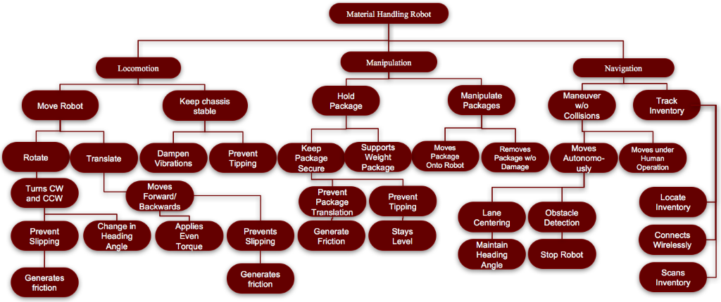
Functional Decomposition
Notes:
3 primary systems:
Locomotion – has to do with physically moving the robot
Manipulation – has to do with moving and manipulating the packages
Navigation – has to do with moving around and navigating around the warehouse
- Inventory Tracking

Slide 43
Material Robot
Locomotion
Move Robot
Keep Chassis Stable
Manipulation
Manipulate Package
Navigation
Hold Package
Track Inventory
Manuever Without Collision

Slide 44
Locomotion
Move Robot
Keep Chassis Stable
Translate
Dampen Vibration
Prevent Tipping
Rotate
Moves Forward and Backward
Turns CW and CCW
Applies even torque
Prevents slipping
Change heading angle
Prevents slipping

Slide 45
Manipulation
Manipulates Package
Moves Package onto Robot
Removes Package from Robot
Holds Package
Keeps Package Secure
Prevent Package Translation
Prevent Package Tipping
Support Package Weight

Slide 46
Navigation
Maneuver without Collision
Moves autonomously
Moves under Human Operation
Track Inventory
Connects to Network
Locates Inventory
Scans Inventory
Lane Centering
Obstacle Detection

Slide 47
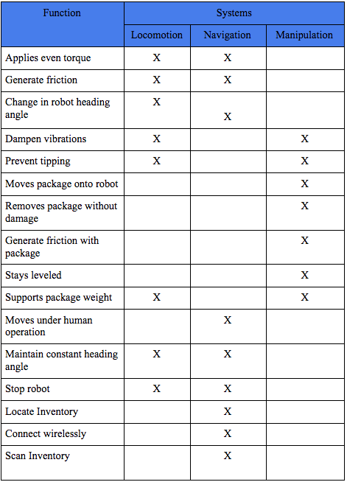

Slide 48
Gant Chart
- Complete
- In Progress
- Pending

